Slide 1

Genome-Phenome of neoplasm across primates phylogeny
02-12-20
Alejandro Valenzuela

Slide 2
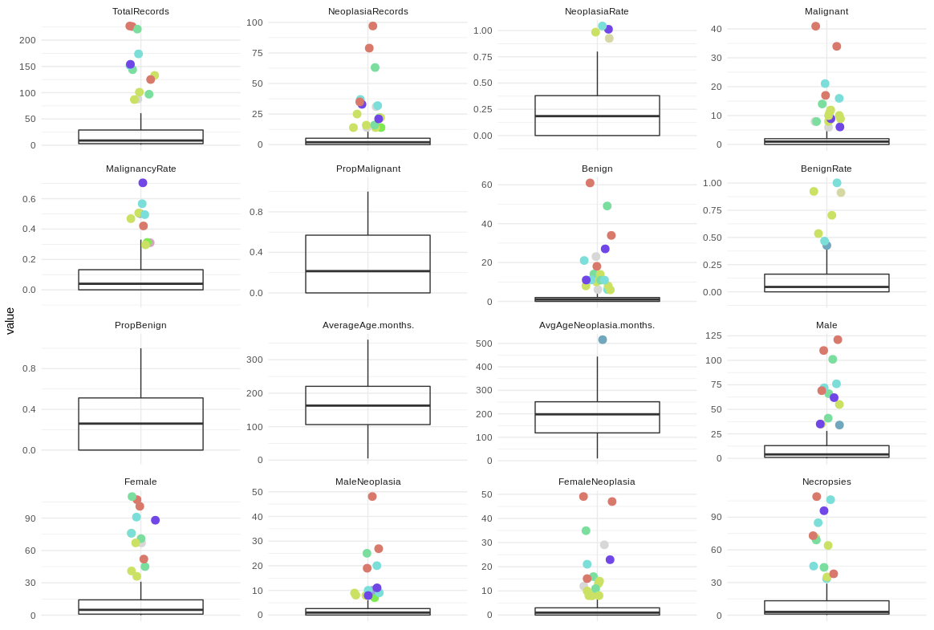
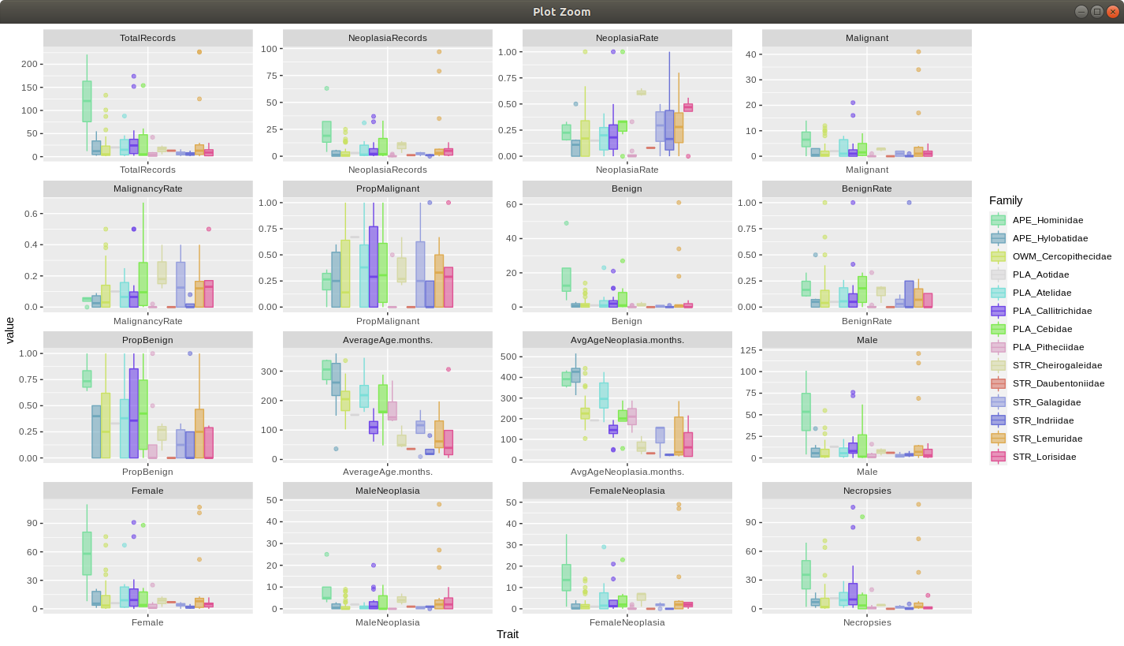

Slide 4
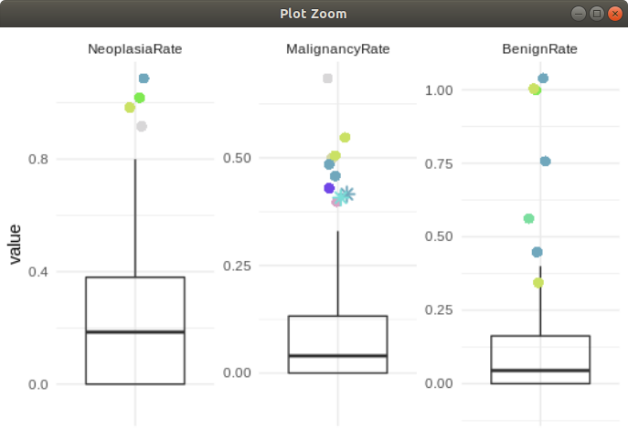
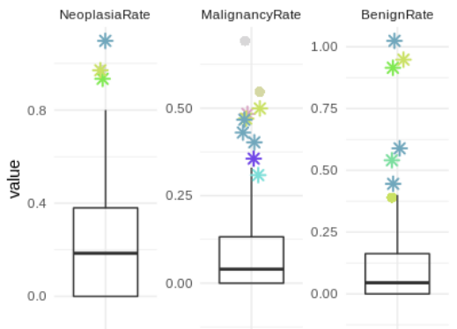
Public species used in our current analysis
Scenario with the 200 primates project
species (*) are those with available genomic information

Slide 5
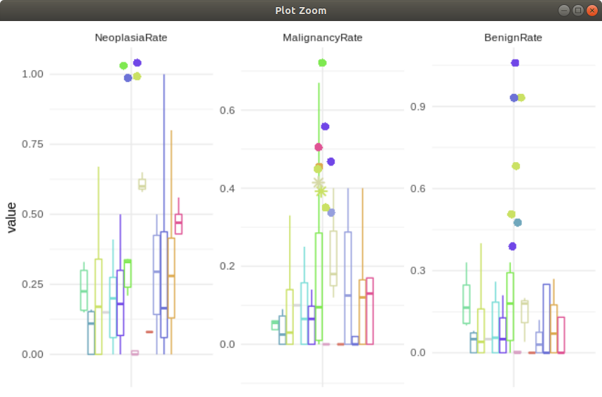
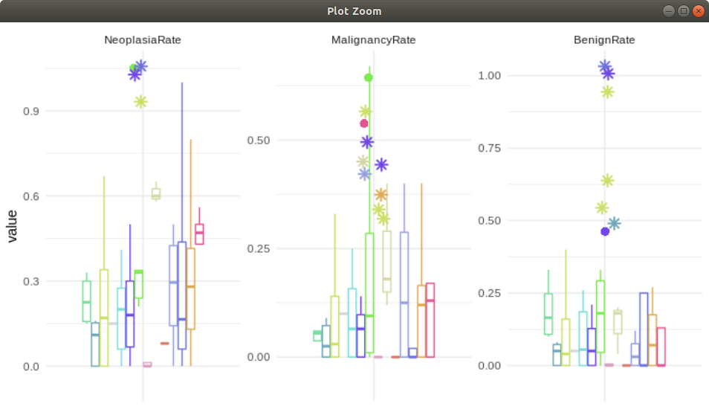
Public species used in our current analysis
Scenario with the 200 primates project
species (*) are those with available genomic information

Slide 6
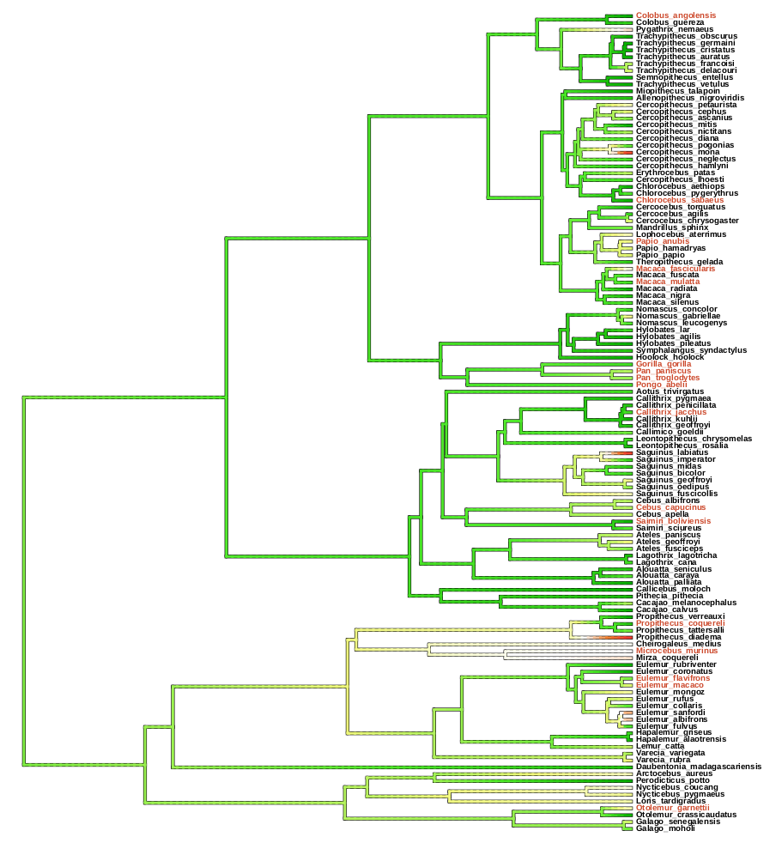
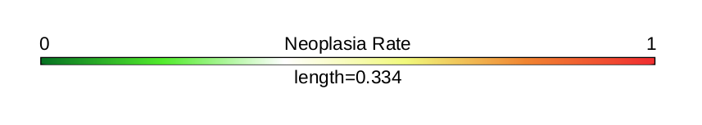
We have used 17 primates genomes coming from UCSC with available multiple sequence alignments for protein-coding regions

Slide 7
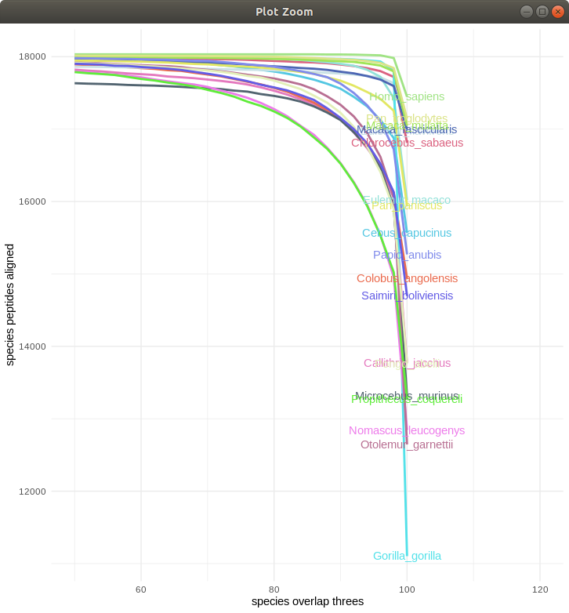
This dataset has been reduced to 16.343 best quality transcripts alignments representing a human gene family. This has been used as our genomic dataset for trait analysis

Slide 8
Trait-association analysis
Convergent aminoacid subtitution (CAAS)
Scenario 1
Scenario 2
Species 1 ---- P S T V Q L M P
Species 1 ---- P S T V Q L M P
Phenotype group A
Phenotype group A
Species 2 ---- P S T V Q L M P
Species 2 ---- P S T V Q L M P
Species 3 ---- P S T V Q L M P
Species 3 ---- P S T V Q L M P
Species 4 ---- P Q T V Q - M P
Species 4 ---- P S R V Q - M P
Phenotype group B
Phenotype group B
Species 5 ---- P Q T V Q L M P
Species 5 ---- P S P V Q L M P
Species 6 ---- P Q T - Q L M P
Species 6 ---- P S M - Q L M P

Slide 9
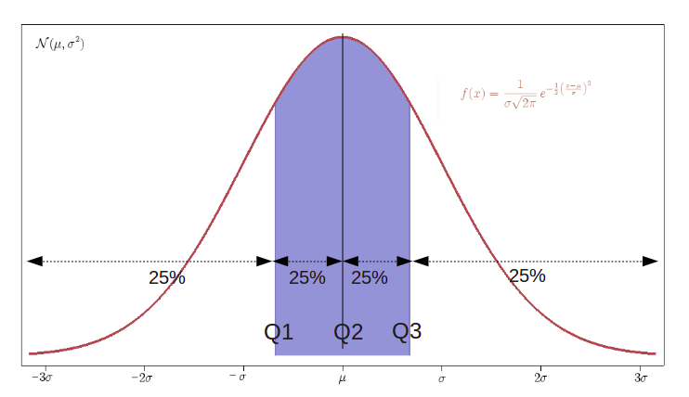
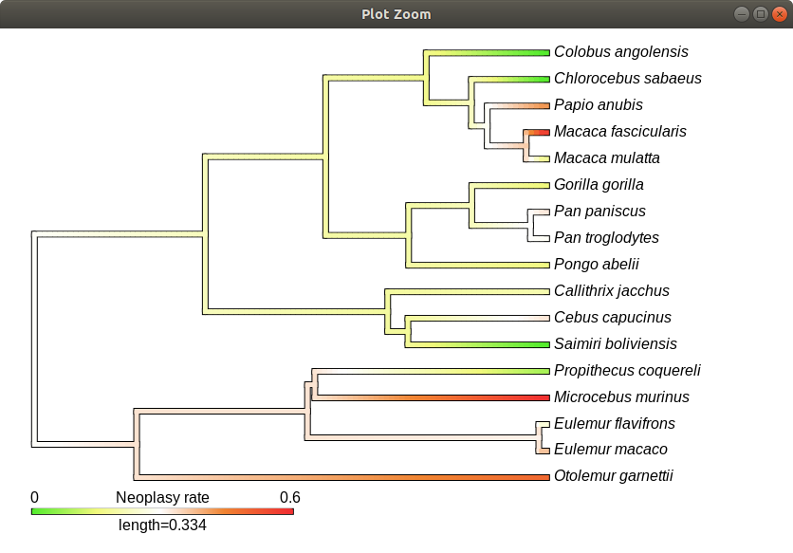
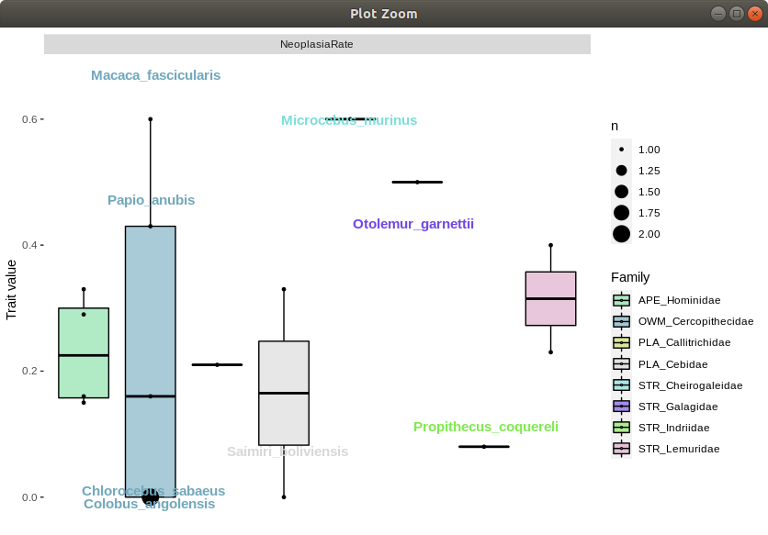
Trait-association analysis
Group selection
Trait groups across phylogeny

Slide 10
First CAAS results
Malignancy Rate
Benign Rate
Neoplasy Rate
with higher risk
Macaca fascicularis
Microcebus murinus
Otolemur garnetti
77 genes
775 aa
with higher risk
Pan paniscus
Pan troglodytes
Papio anubis
Cebus capucinus
4 genes
13 aa
with higher risk
Papio_anubis
Macaca_fascicularis
Microcebus murinus
Otolemur garnetti
with lower risk
Propithecus coquereli
Saimiri boliviensis
Chlorocebus sabaeus
Colobus angolensis
127 genes
210 aa

Slide 11
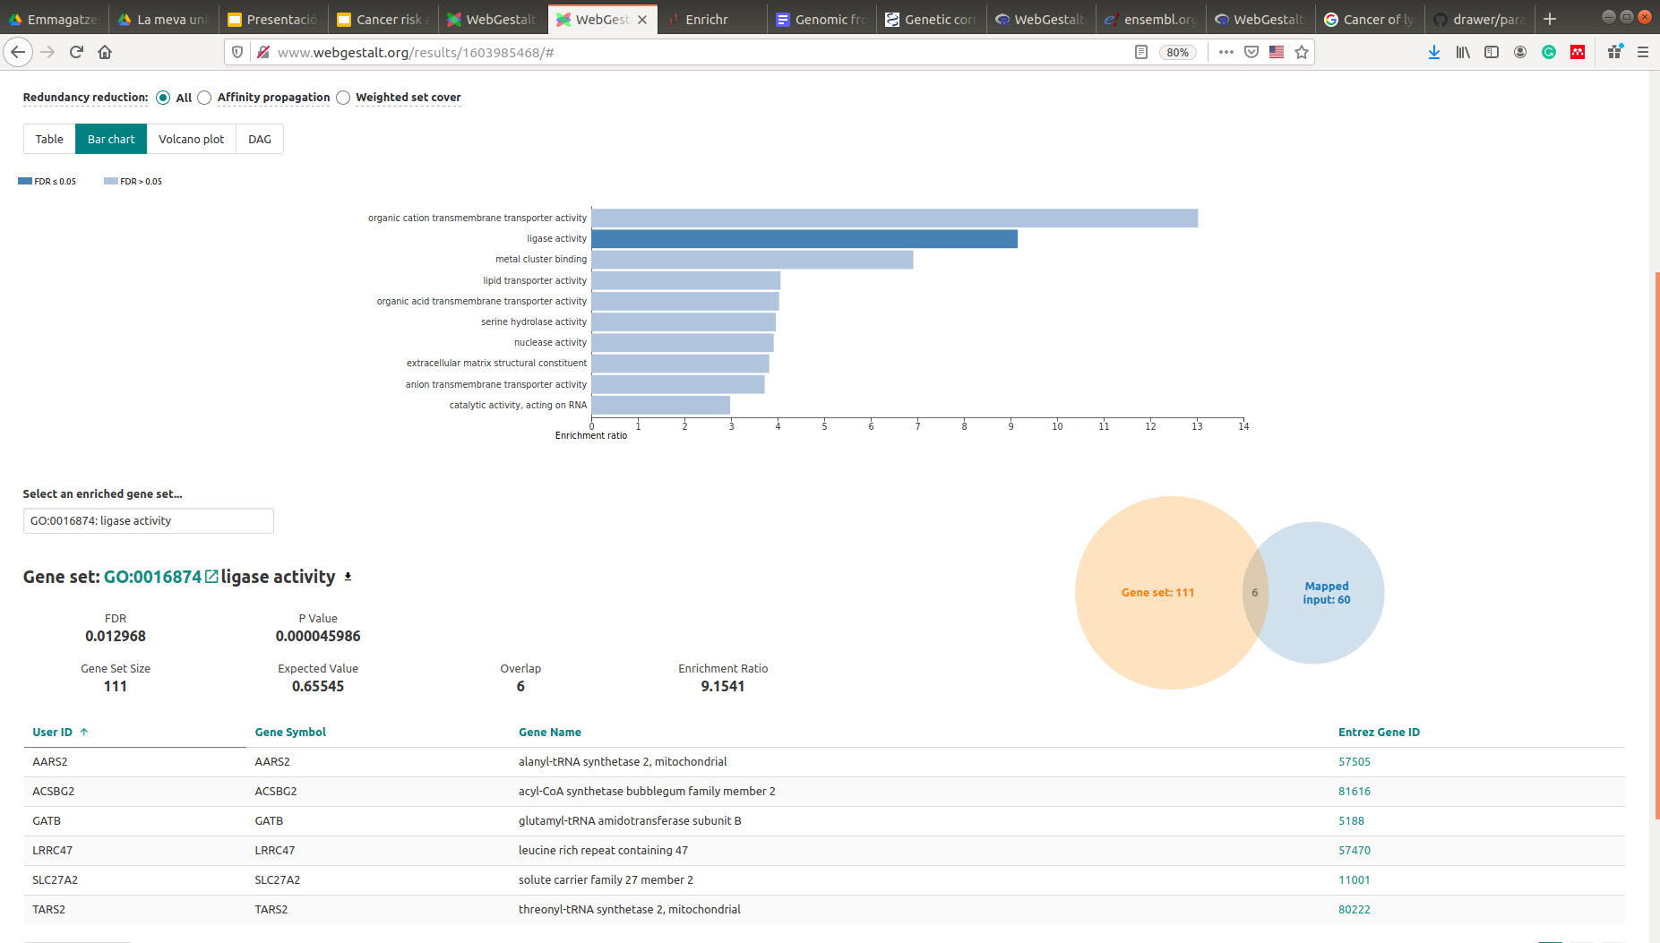
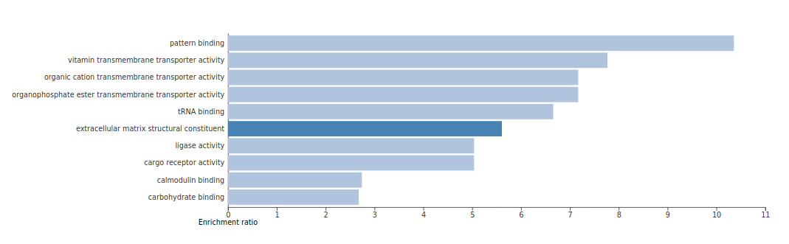
First CAAS results
WebGestaltR
Main molecular functions

Slide 12
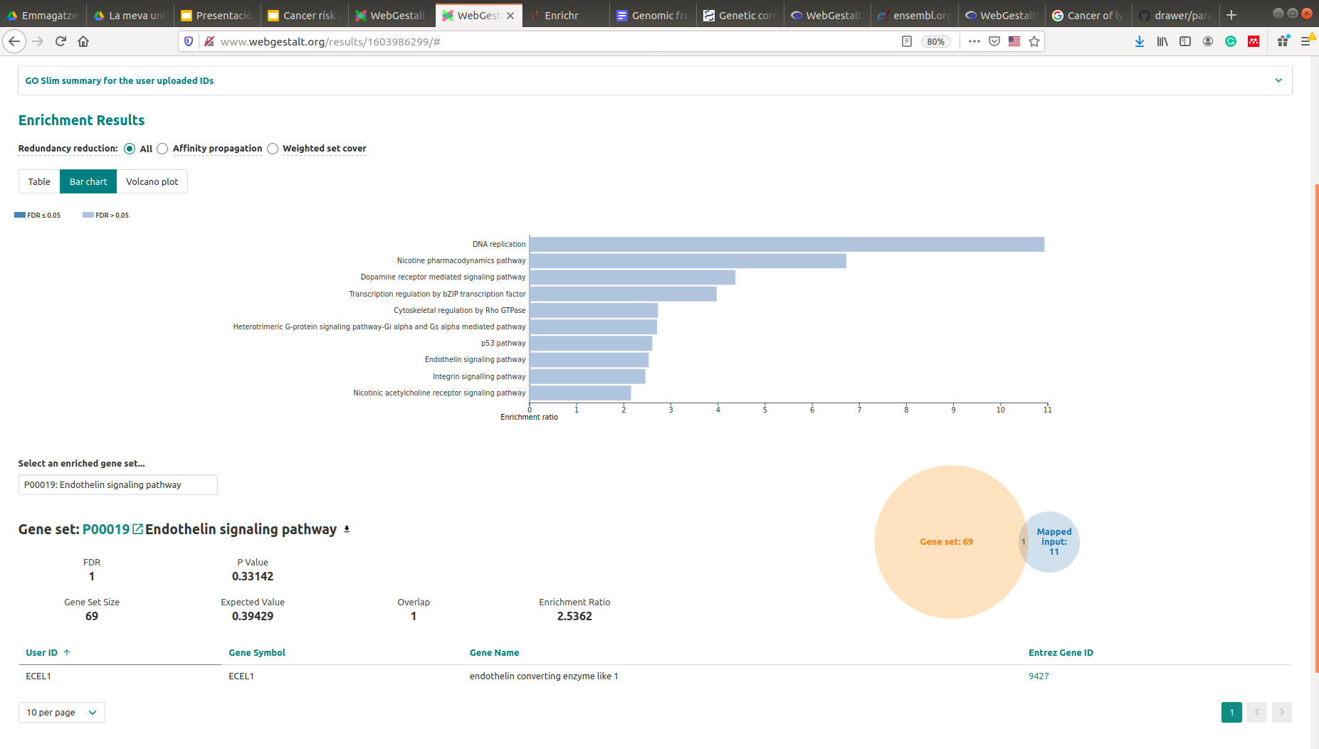
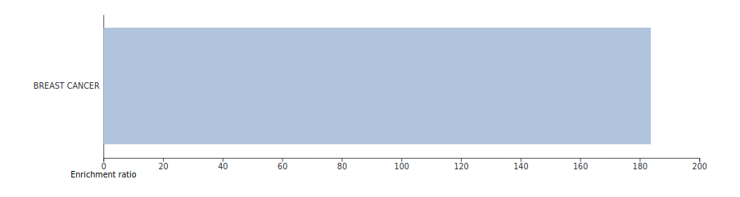
First CAAS results
WebGestaltR
Neoplasy Rate - Pathways and diseases
Scenarios 1+2

Slide 13
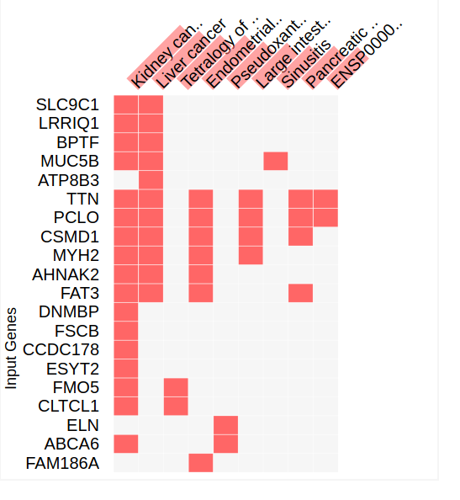
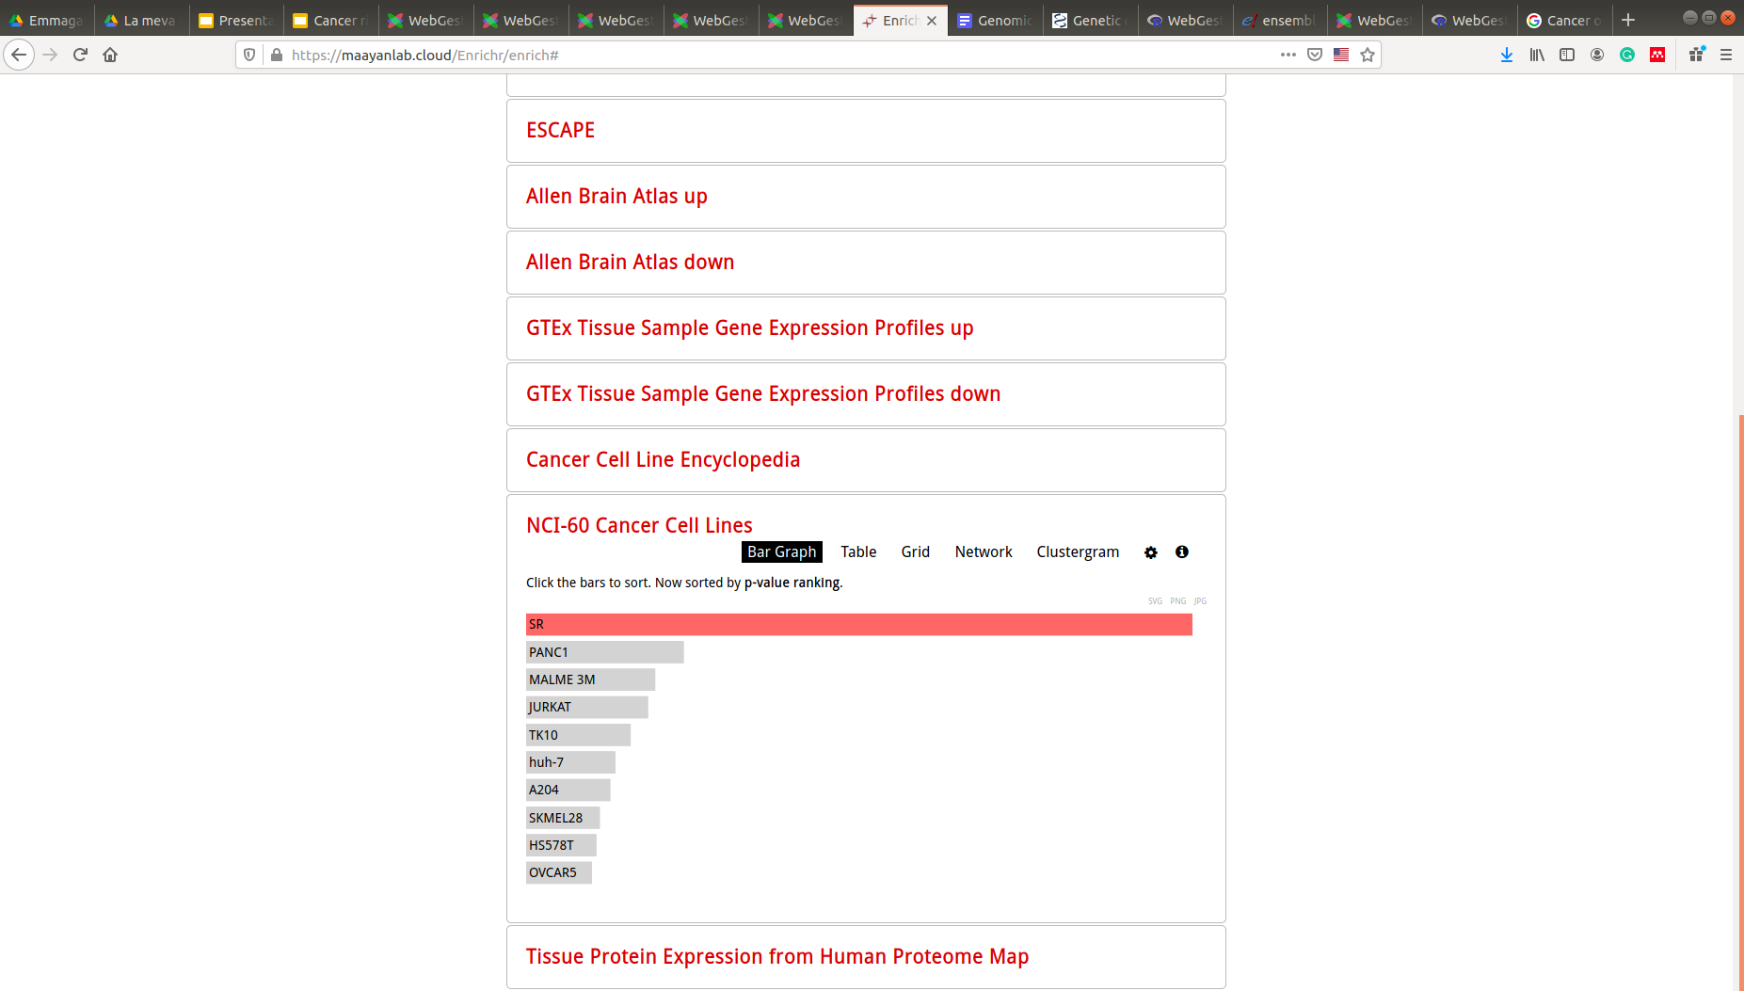
First CAAS results
enrichR
Neoplasy Rate - Cancer-linked insights
Scenarios 1+2

Slide 14
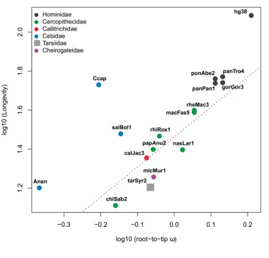
Trait-association analysis
Phylogenetic generalised least-squares (PGLS)
Regression between a genetic predictor variable (root-to-tip dN/dS) and a trait response variable (neoplasy trait) across a phylogeny,
controlling for non-independence of species data points
Muntané et al. (2018). Biological processes modulating longevity across primates: A phylogenetic genome-phenome analysis. Molecular Biology and Evolution

Slide 15
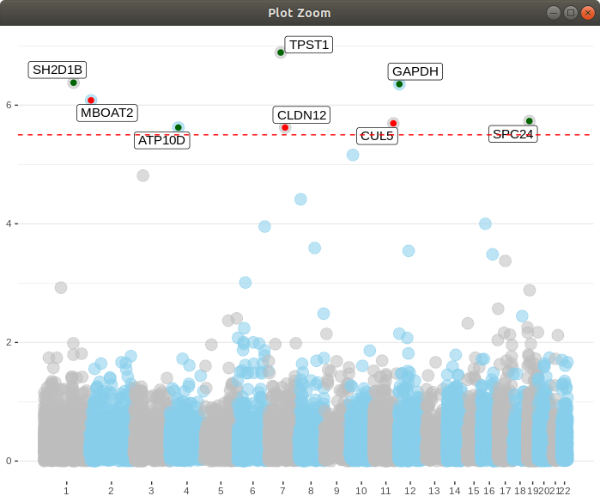
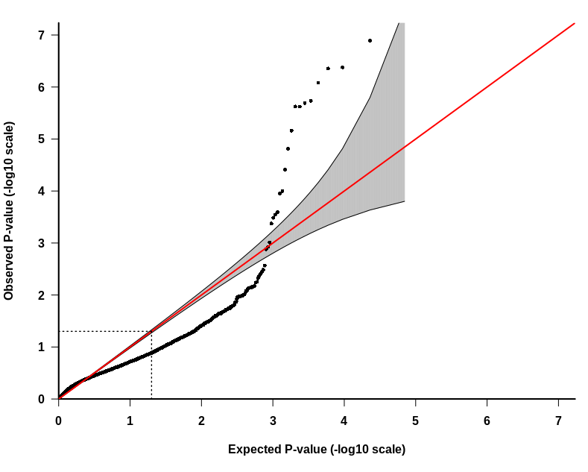
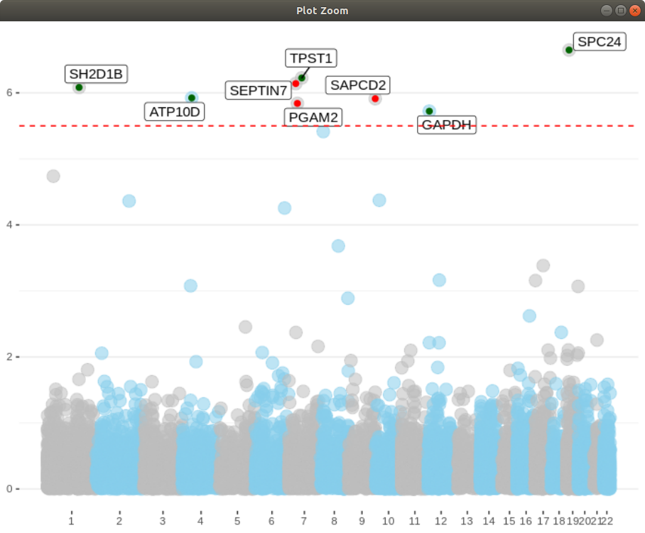
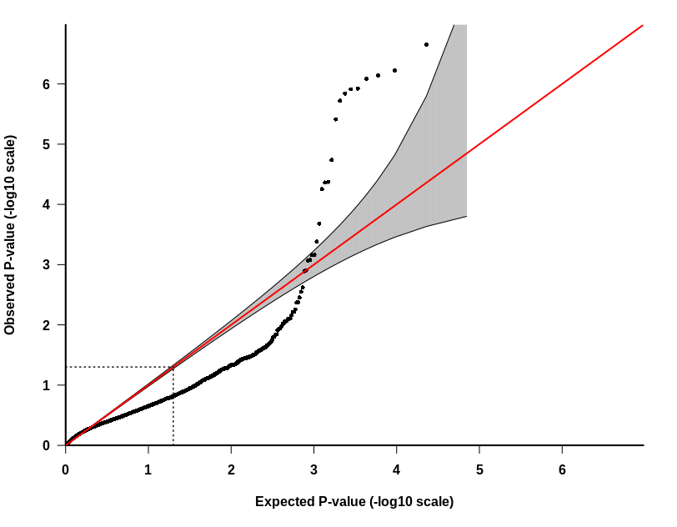
First PGLS results - Malignancy traits
+ correlation
- correlation
-log10(p-val)
Malignancy rate
red line → Bonferroni significance threeshold
B) Malignancy proportion over neoplasies
-log10(p-val)

Slide 16
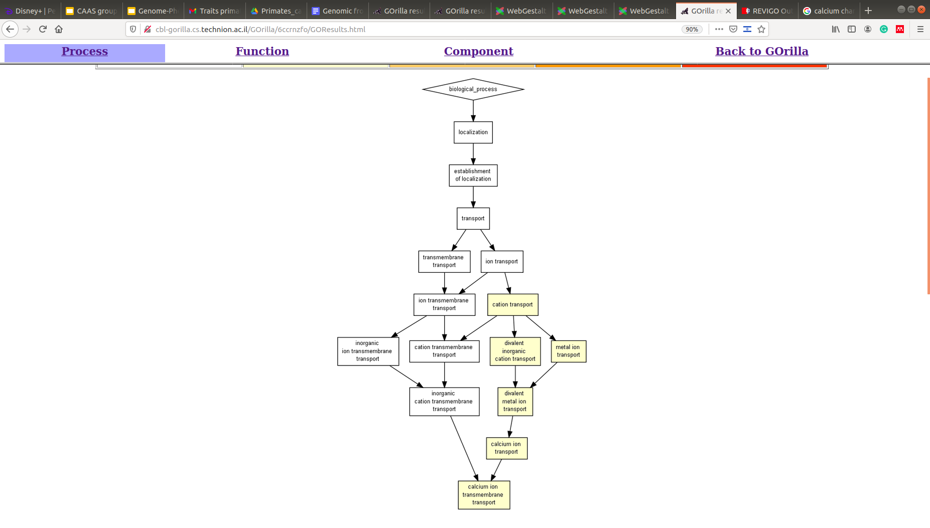
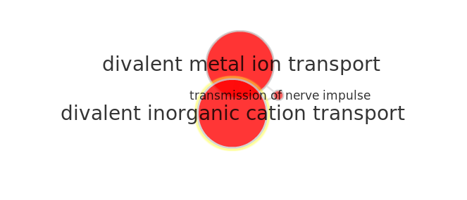
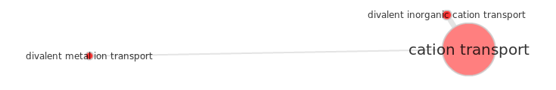
First PGLS results - Malignancy traits
Target genes enrichment
Top 50-100 genes ranked by p-value
> Link with calcium/ion transport channels
(pval < 10-3)

Slide 17
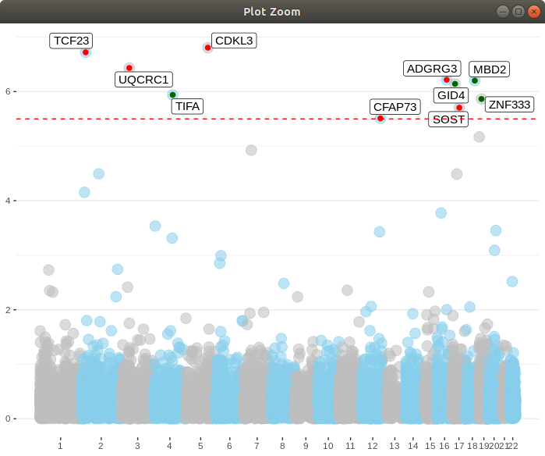

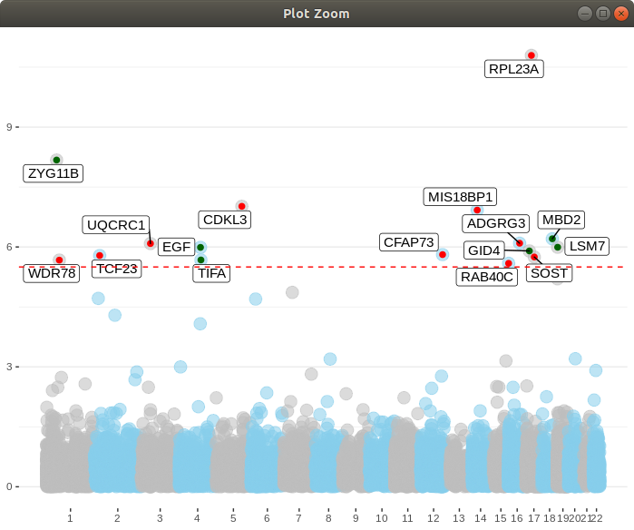
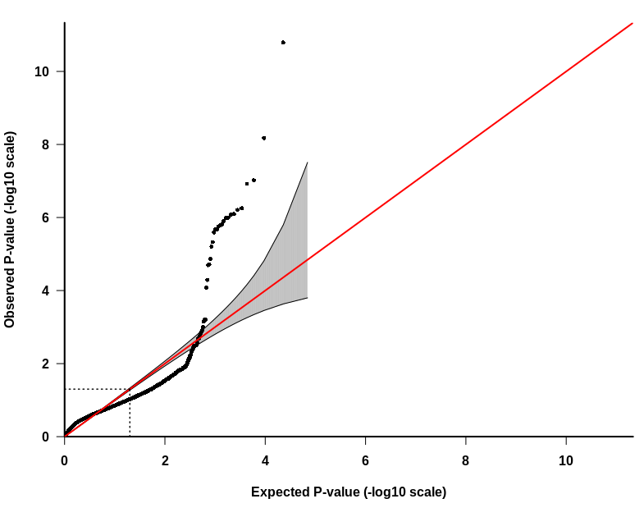
First PGLS results - Benignancy traits
+ correlation
- correlation
Benignancy rate
-log10(p-val)
red line → Bonferroni significance threeshold
B) Benignancy proportion over neoplasies
-log10(p-val)

Slide 18
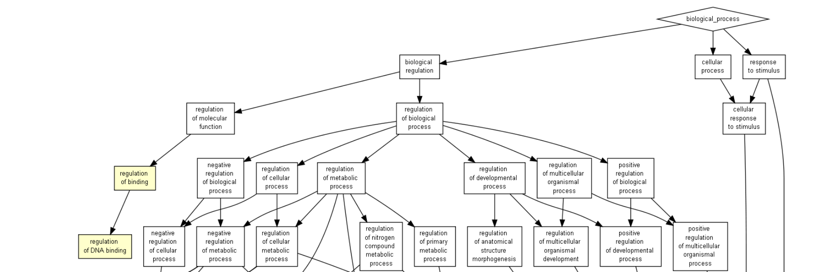
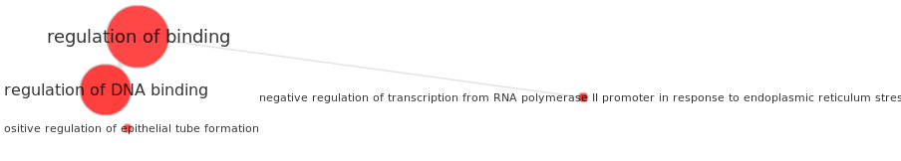
First PGLS results - Benignancy traits
Target genes enrichment
> Link with DNA Binding
(pval < 10-3)

Slide 19
Some questions and final conclusions
With the increase of genomic information from outlier primate species in the tree, the groupping approach can improve in terms of sensitivity.
> Regarding the traits selected, how much differ the quality between each one?
> Do these trait measurements belong to specific cancer types?
> Are they linked to the expression of specific cancerous cell lines?

